Slide 1

Invited talk: Bioinformatics x AI
Week 2 - Intro to Deep Learning
Lecturer：Dongzhan Zhou
Date：

Slide 2
讲师介绍
周东展 博士
上海人工智能实验室 青年科学家
主要研究方向为AI for Science，包括Sci-LLM&VLM，AI4Computing，科学具身智能和自动化实验室等，关注AI在物理和生物领域的应用
南京大学物理学学士，悉尼大学人工智能博士，师从欧阳万里教授
在人工智能和物理学顶级期刊和会议上发表论文十余篇
联系方式：zhoudongzhan@pjlab.org.cn

Slide 3

Lecture Plan
Week 1 - Basics of Artificial Intelligence
Week 2 - Intro to Deep Learning
Week 3 - Intro to LLMs

Slide 4
Outline of Week 2
What is Deep Learning
Convolutional Neural Network and Computer Vision
Recurrent Neural Network and Transformer

Slide 5
1 | What is Deep Learning

Slide 6
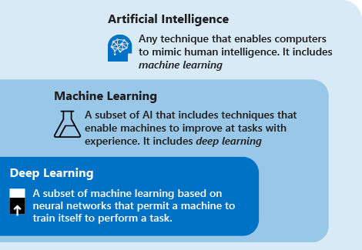
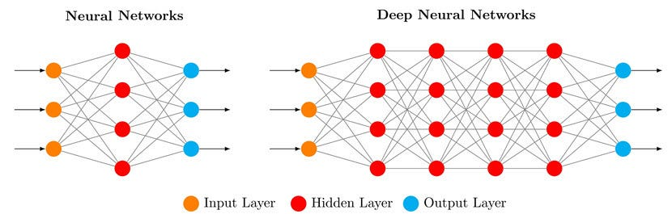
Contents Last week – Deep Learning
What is Deep Learning
A subset of Machine Learning
Inspired by the structure and function of the human brain
Utilizes Deep Artificial Neural Networks (ANNs) to process data
Capable of learning from large datasets
Notes:
给多个定义

Slide 7
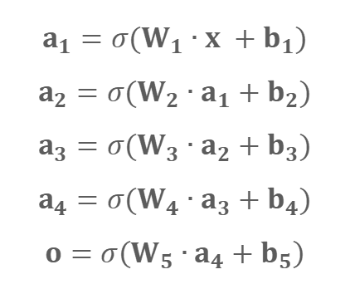
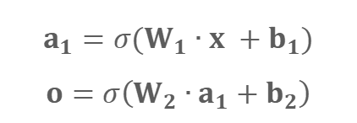
Namely
$$a_{1}=σ(W_{1}∙x +b_{1})$$
$$o=σ\left(W_{2}∙a_{1}+b_{2}\right)$$
$$a_{1}=σ(W_{1}∙x +b_{1})$$
$$a_{2}=σ(W_{2}∙a_{1}+b_{2})$$
$$a_{3}=σ(W_{3}∙a_{2}+b_{3})$$
$$a_{4}=σ(W_{4}∙a_{3}+b_{4})$$
$$o=σ\left(W_{5}∙a_{4}+b_{5}\right)$$
Notes:
给多个定义

Slide 8
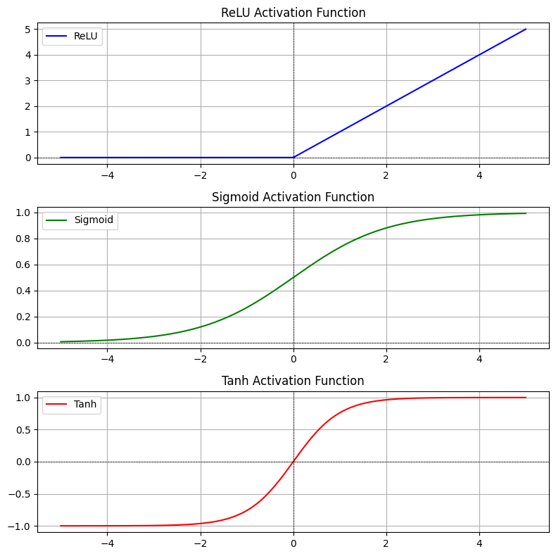
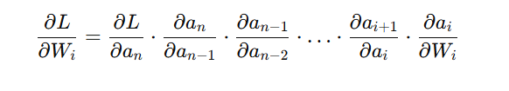
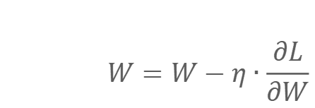
Deep Learning – Key Components
Neural Networks (ANNs, CNNs, RNNs)
Layers: Input, Hidden, Output
Activation Functions: ReLU, Sigmoid, etc.
Training with Backpropagation
$$W=W−η∙\frac{∂L}{∂W}$$
Notes:
给多个定义

Slide 9
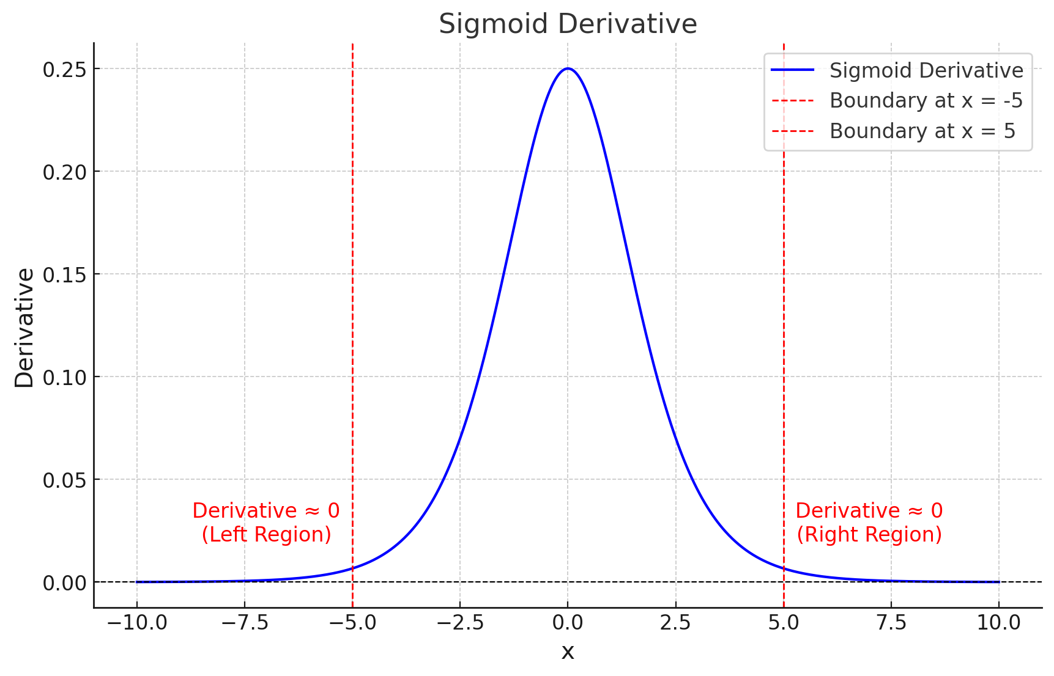
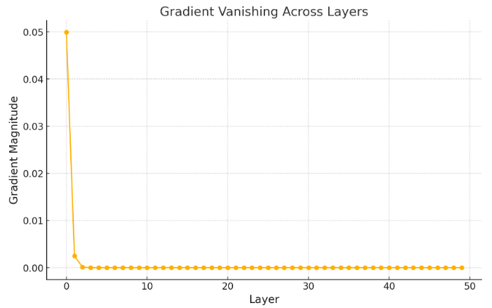
Gradient Vanishment
As the gradient propagates backward through many layers, it becomes smaller and smaller due to repeated multiplication by the derivative of the activation function (here using sigmoid), leading to near-zero updates for earlier layers.
We are only learning the last few layers!
Notes:
给多个定义

Slide 10

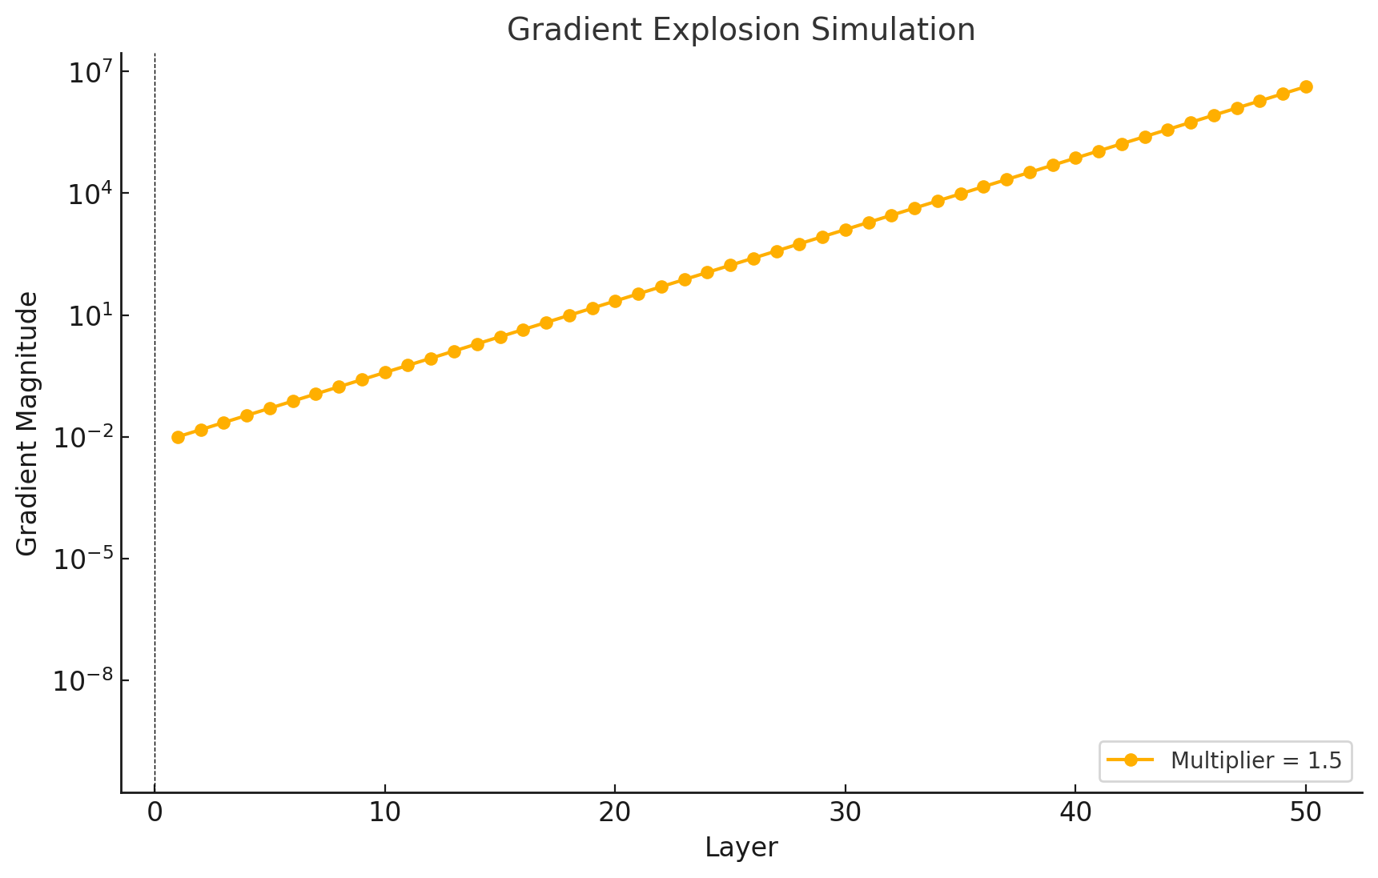
Opposite – Gradient Explosion
On the contrary, when we are using activation functions like ReLU or we don’t initialize the weights appropriately (too large). Repeated multiplication may lead to Gradient Explosion.
Notes:
给多个定义

Slide 11
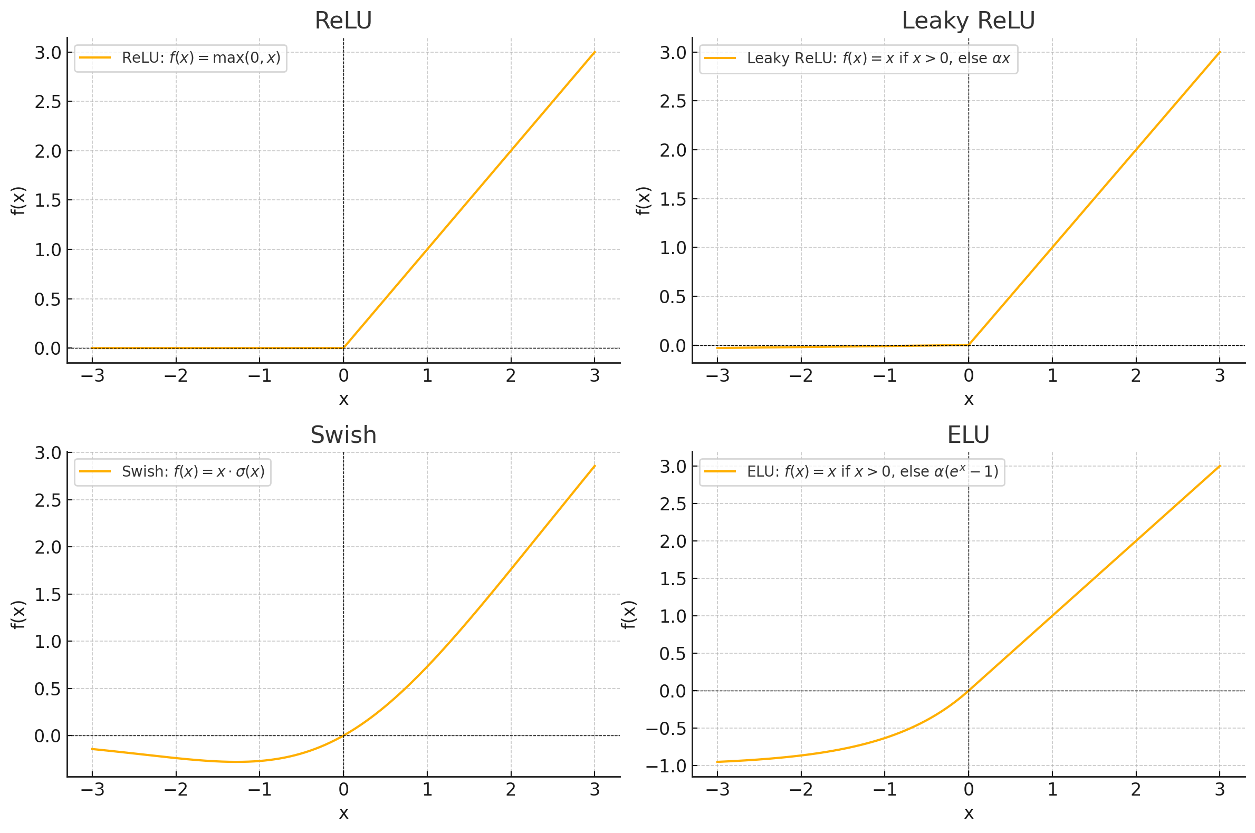
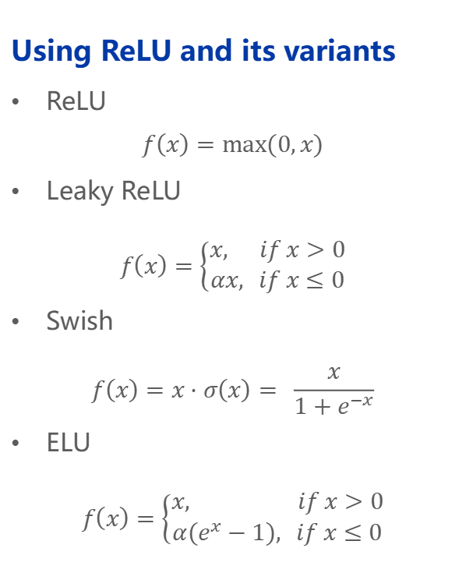
Manage Gradient– Activation Function
Using ReLU and its variants
ReLU
$$f\left(x\right)=max⁡(0,x)$$
Leaky ReLU
$$f\left(x\right)=\left\{\begin{aligned}x, if x>0 \\ αx, if x≤0\end{aligned}\right.$$
Swish
$$f\left(x\right)=x⋅σ\left(x\right)= \frac{x}{1+e^{−x}}$$
ELU
$$f\left(x\right)=\left\{\begin{aligned}x, if x>0 \\ α(e^{x}−1), if x≤0\end{aligned}\right.$$
Compared to sigmoid, ReLU avoids the large zero-derivative region
Compared to original ReLU, improved versions avoid zero derivatives for negative activations (Dead Neuron Problem)
Notes:
给多个定义

Slide 12
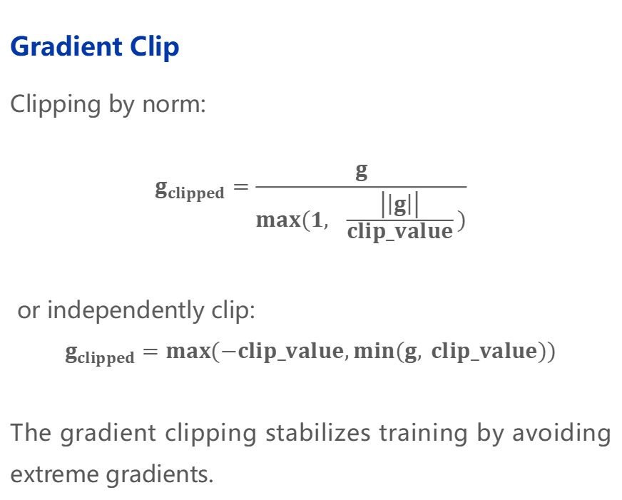
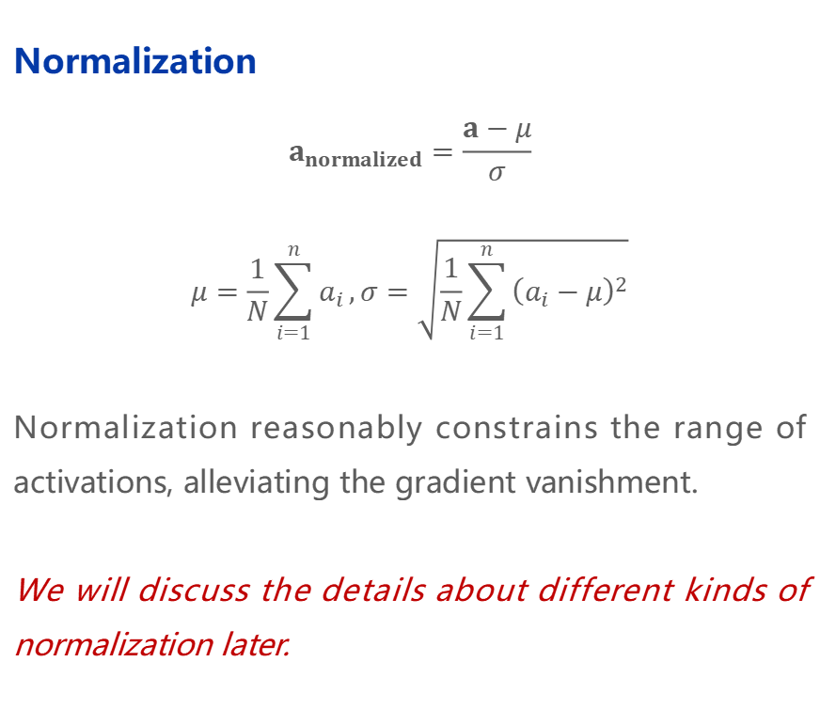
Manage Gradient – Normalization and Gradient Clip
Normalization
$$a_{normalized}=\frac{a−μ}{σ}$$
$$μ=\frac{1}{N}\sum_{i=1}^{n}{a_{i}},σ=\sqrt{\frac{1}{N}\sum_{i=1}^{n}{{\left(a_{i}−μ\right)}^{2}}}$$
Normalization reasonably constrains the range of activations, alleviating the gradient vanishment.
We will discuss the details about different kinds of normalization later.
Gradient Clip
Clipping by norm:
$$g_{clipped}=\frac{g}{max(1, \frac{\left|\left|g\right|\right|}{clip_value})}$$
or independently clip:
$$g_{clipped}=max(−clip_value,min(g, clip_value))$$
The gradient clipping stabilizes training by avoiding extreme gradients.
Notes:
给多个定义

Slide 13
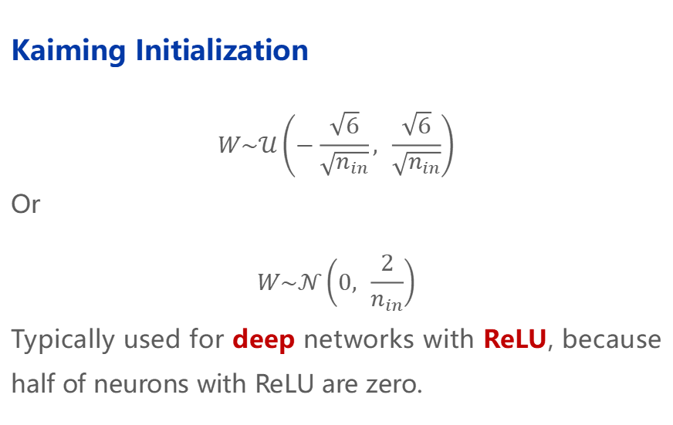
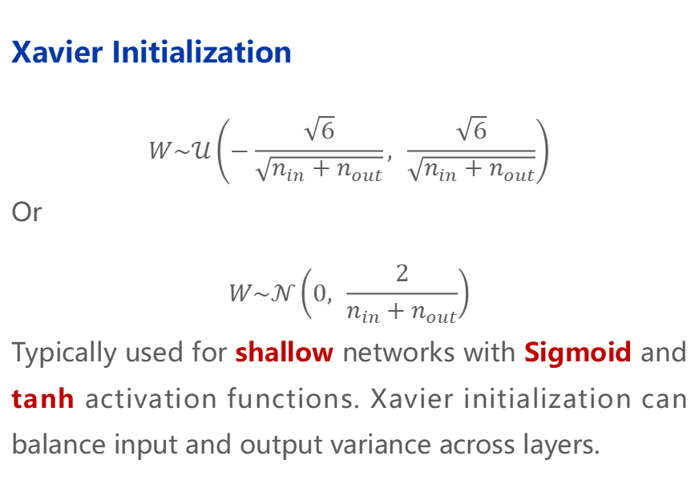
Manage Gradient – Appropriate Initialization
Key: Maintain the variance of activations consistent across layers
Xavier Initialization
$$W\sim 𝒰\left(−\frac{\sqrt{6}}{\sqrt{n_{in}+n_{out}}}, \frac{\sqrt{6}}{\sqrt{n_{in}+n_{out}}}\right)$$
Or
$$W\sim 𝒩\left(0, \frac{2}{n_{in}+n_{out}}\right)$$
Typically used for shallow networks with Sigmoid and tanh activation functions. Xavier initialization can balance input and output variance across layers.
Kaiming Initialization
$$W\sim 𝒰\left(−\frac{\sqrt{6}}{\sqrt{n_{in}}}, \frac{\sqrt{6}}{\sqrt{n_{in}}}\right)$$
Or
$$W\sim 𝒩\left(0, \frac{2}{n_{in}}\right)$$
Typically used for deep networks with ReLU, because half of neurons with ReLU are zero.
Notes:
恺明初始化比xavier初始化的值要大一些，方差大，因为relu的一半是0，是不对称的特性。Tanh和sigmoid是对称的

Slide 14
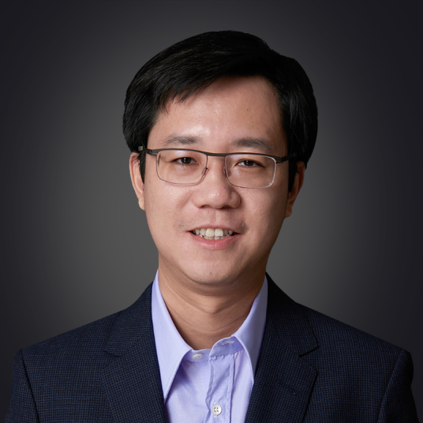
Who is Kaiming He
Kaiming He
One of the most impactful AI researchers
Supervised by Prof. Xiaoou Tang, and Prof. Jian Sun
Introduced ResNet in 2015 (Cited over 240k times)
Focal loss, Mask R-CNN, Group Normalization, Momentum Contrast …
CVPR Best Paper 2009 & 2016, Marr Prize 2017

Slide 15
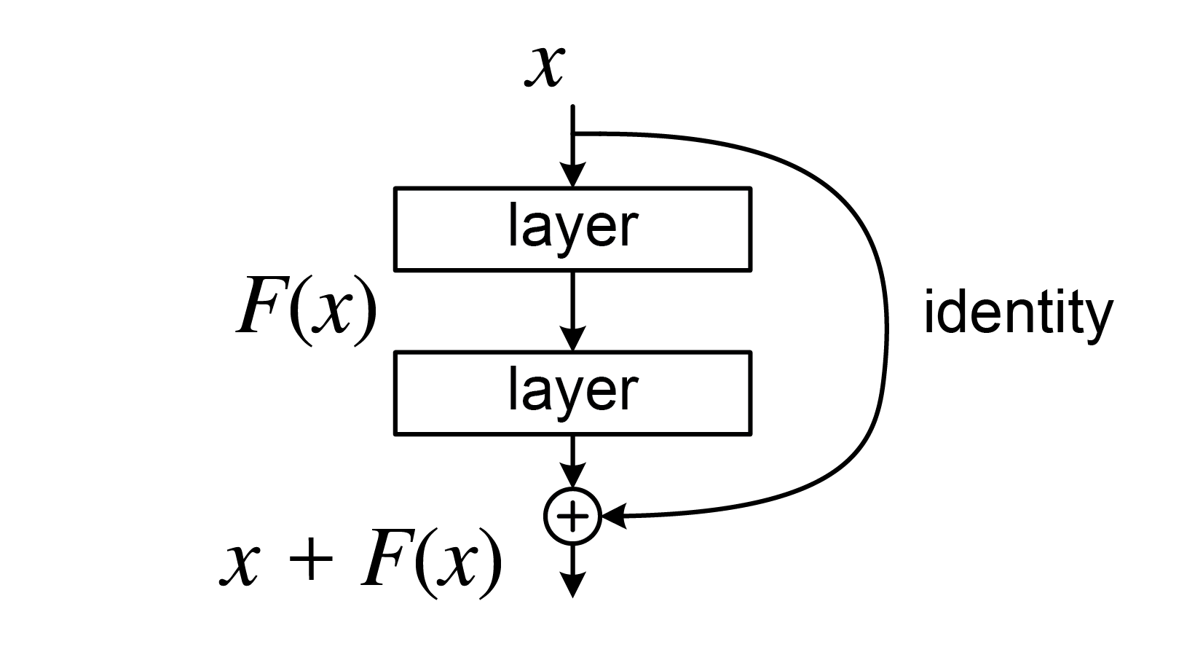
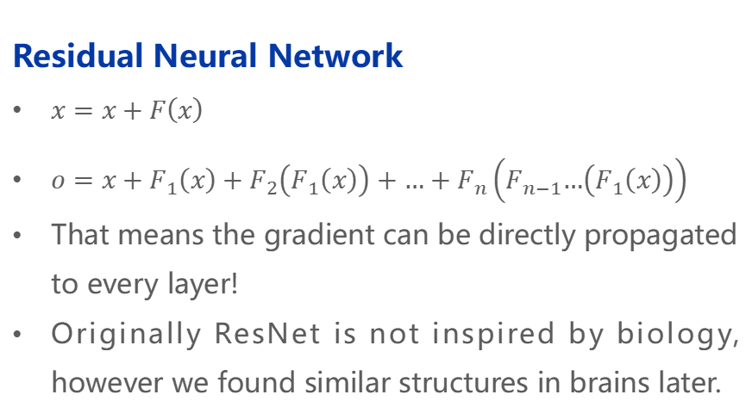
Manage Gradient – Network Structure
Residual Neural Network
$x=x+F\left(x\right)$
$o=x+F_{1}\left(x\right)+F_{2}\left(F_{1}\left(x\right)\right)+…+F_{n}\left(F_{n−1}…\left(F_{1}\left(x\right)\right)\right)$
That means the gradient can be directly propagated to every layer!
Originally ResNet is not inspired by biology, however we found similar structures in brains later.
We will talk about the convolutional residual module later.

Slide 16
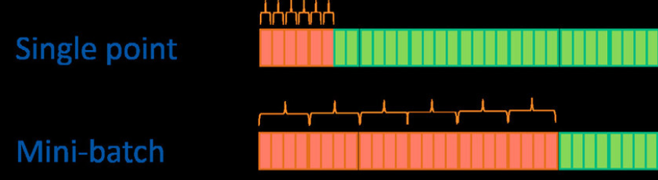
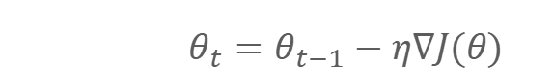
Manage Gradient – Optimizer
Gradient Descent
Batch Gradient Descent
Calculating the average gradient of all training samples to update the parameters.
It is computationally inefficient and memory-intensive.
Stochastic Gradient Descent
Using only one sample at a time to update the parameters.
Advantage: Low computational cost.
Disadvantage: The convergence process may be unstable.
Mini-batch Stochastic Gradient Descent
Improves efficiency and stability by using small batches of samples.
$$W=W−η∙\frac{∂L}{∂W}$$
or
$$θ_{t}=θ_{t−1}−η∇J(θ)$$
Notes:
Nabla符号在优化的理论里更加约定俗成，表达更加简洁

Slide 17
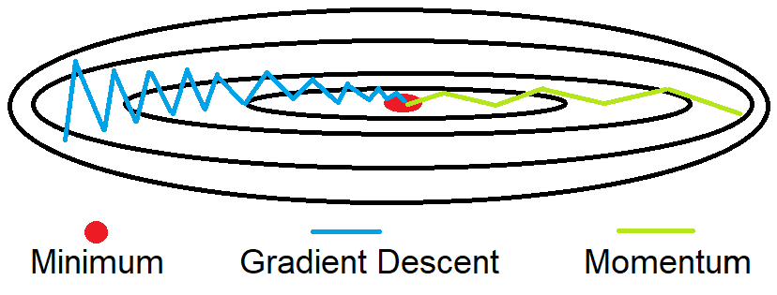
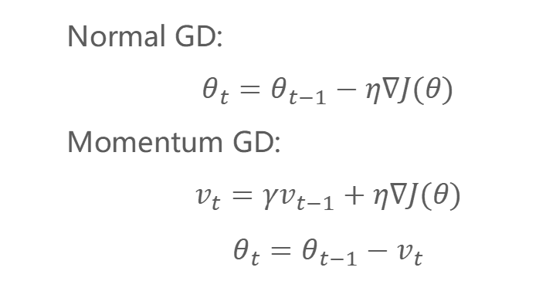
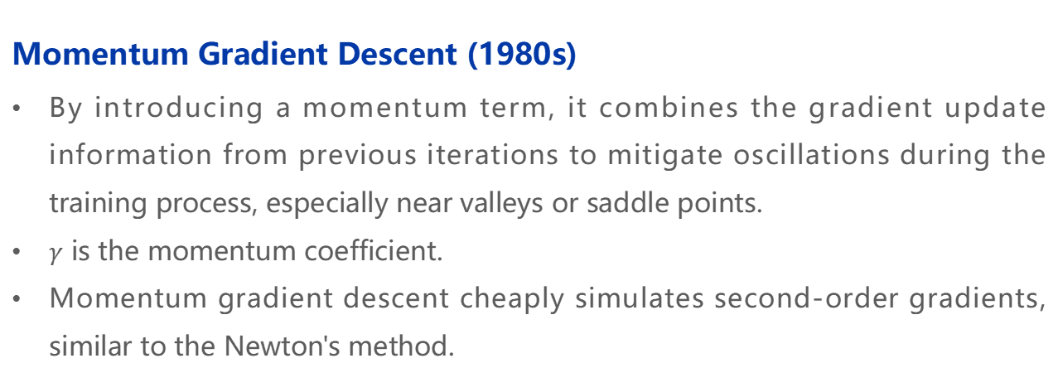
Manage Gradient – Optimizer
Momentum Gradient Descent (1980s)
By introducing a momentum term, it combines the gradient update information from previous iterations to mitigate oscillations during the training process, especially near valleys or saddle points.
$γ$ is the momentum coefficient.
Momentum gradient descent cheaply simulates second-order gradients, similar to the Newton's method.
Normal GD:
$$θ_{t}=θ_{t−1}−η∇J(θ)$$
Momentum GD:
$$v_{t}=γv_{t−1}+η∇J(θ)$$
$$θ_{t}=θ_{t−1}−v_{t}$$

Slide 18
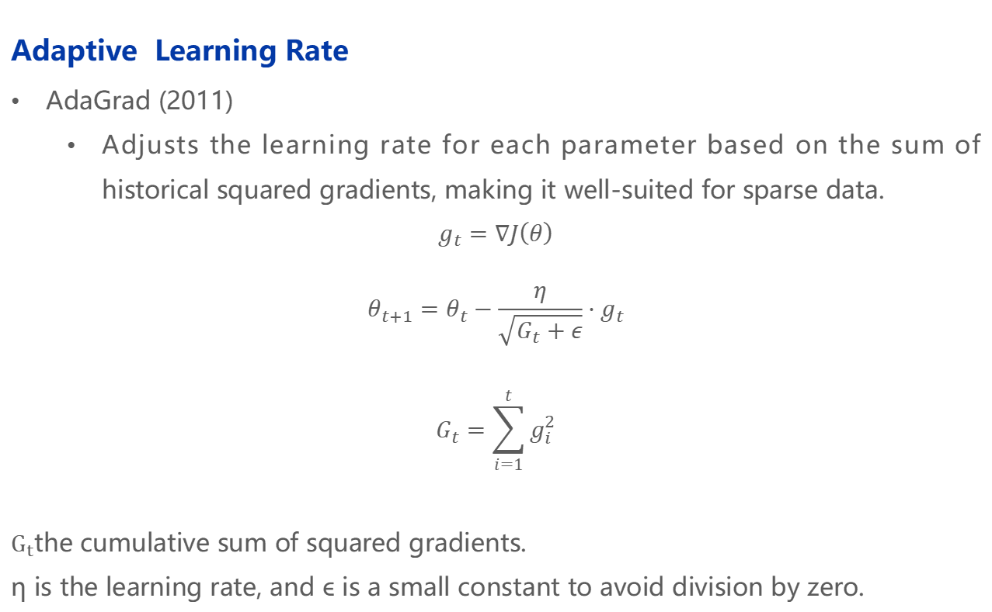
Manage Gradient – Optimizer
Adaptive Learning Rate
AdaGrad (2011)
Adjusts the learning rate for each parameter based on the sum of historical squared gradients, making it well-suited for sparse data.
$$g_{t}=∇J\left(θ\right)$$
$$θ_{t+1}=θ_{t}−\frac{η}{\sqrt{G_{t}+ε}}⋅g_{t}$$
$$G_{t}=\sum_{i=1}^{t}{g_{i}^{2}}$$
$G_{t}$the cumulative sum of squared gradients.
η is the learning rate, and ϵ is a small constant to avoid division by zero.
If historical cumulative gradients are high, the learning rate will be adjusted lower, vice versa.

Slide 19
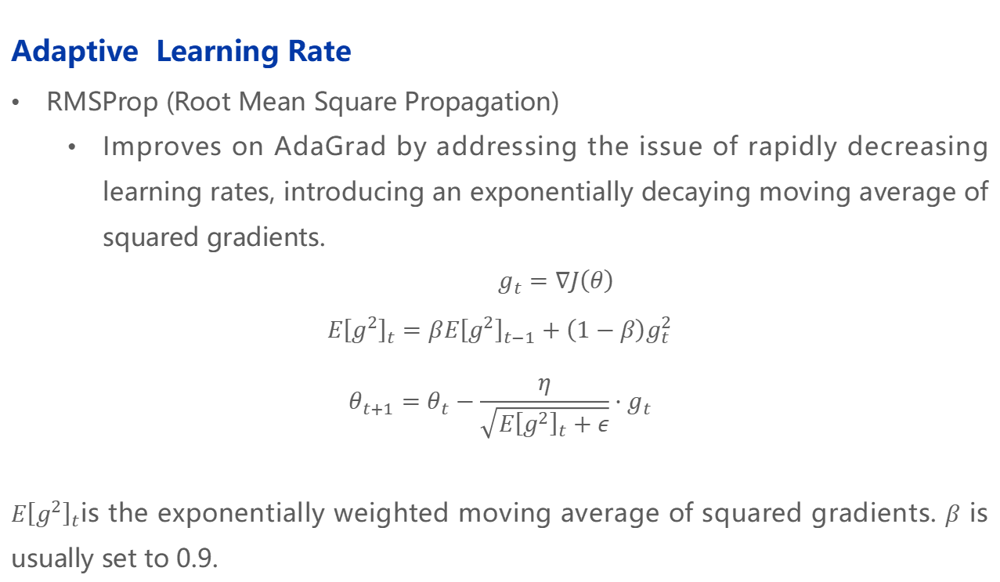
Manage Gradient – Optimizer
Adaptive Learning Rate
RMSProp (Root Mean Square Propagation)
Improves on AdaGrad by addressing the issue of rapidly decreasing learning rates, introducing an exponentially decaying moving average of squared gradients.
$$g_{t}=∇J\left(θ\right)$$
$$E{\left[g^{2}\right]}_{t}=βE{\left[g^{2}\right]}_{t−1}+\left(1−β\right)g_{t}^{2}$$
$$θ_{t+1}=θ_{t}−\frac{η}{\sqrt{E{\left[g^{2}\right]}_{t}+ε}}⋅g_{t}$$
$E{\left[g^{2}\right]}_{t}$is the exponentially weighted moving average of squared gradients. $β$ is usually set to 0.9.

Slide 20
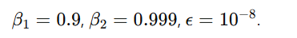
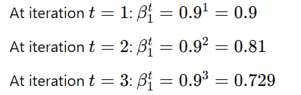
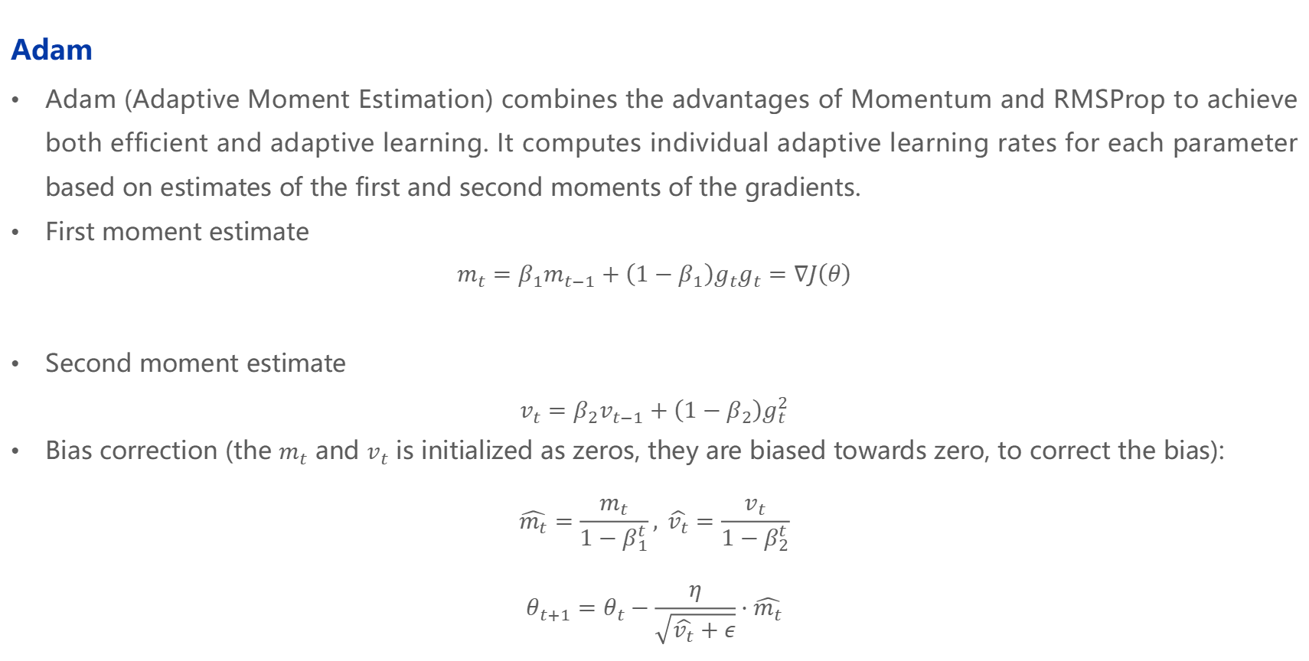
Manage Gradient – Optimizer
Adam
Adam (Adaptive Moment Estimation) combines the advantages of Momentum and RMSProp to achieve both efficient and adaptive learning. It computes individual adaptive learning rates for each parameter based on estimates of the first and second moments of the gradients.
First moment estimate
$$m_{t}=β_{1}m_{t−1}+\left(1−β_{1}\right)g_{t}g_{t}=∇J\left(θ\right)$$
Second moment estimate
$$v_{t}=β_{2}v_{t−1}+\left(1−β_{2}\right)g_{t}^{2}$$
Bias correction (the $m_{t}$ and $v_{t}$ is initialized as zeros, they are biased towards zero, to correct the bias):
$$\hat{m_{t}}=\frac{m_{t}}{1−β_{1}^{t}}, \hat{v_{t}}=\frac{v_{t}}{1−β_{2}^{t}}$$
$$θ_{t+1}=θ_{t}−\frac{η}{\sqrt{\hat{v_{t}}+ε}}⋅\hat{m_{t}}$$

Slide 21

Manage Gradient – Optimizer
Saddle Point
A saddle point is a critical point on the loss surface where the gradient is zero but the curvature is mixed—upwards in some directions and downwards in others.
Gradient descent with momentum and adaptive learning rate can handle such a problem.

Slide 22
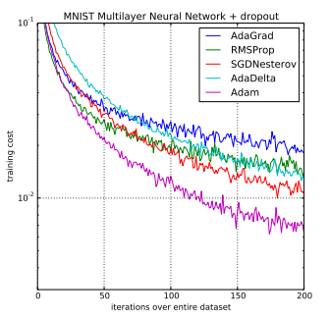

Manage Gradient – Optimizer
Choose your optimizer
In computer vision practice, using Adam often yields good results, especially when your network structure is very complex. However, if you are competing for top accuracy or aiming for the optimal results, you should use Nesterov momentum GD.
Now, for LLMs, we use Adam or AdamW.
We have to admit we know very little about the theory of deep learning optimizers, because it is usually a highly Non-Convex Optimization probelm. Remember that deep learning is an empirical practice, not a theoretical one.

Slide 23
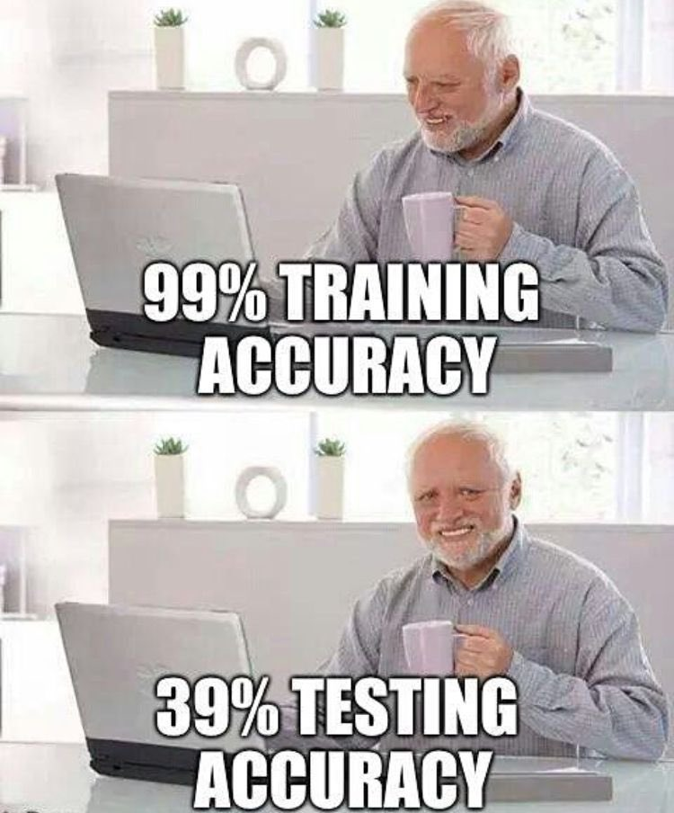
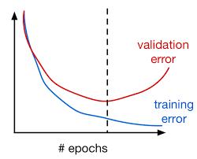
Recall Overfitting
Deep Learning has much more parameters than traditional Machine Learning methods (Over parameterization). Usually, overfitting in Deep Learning is catastrophic.
Overfitting will make the model fail in the test dataset, which may mean that the model has remembered all the data in the training set, but cannot be generalized to unseen data.

Slide 24

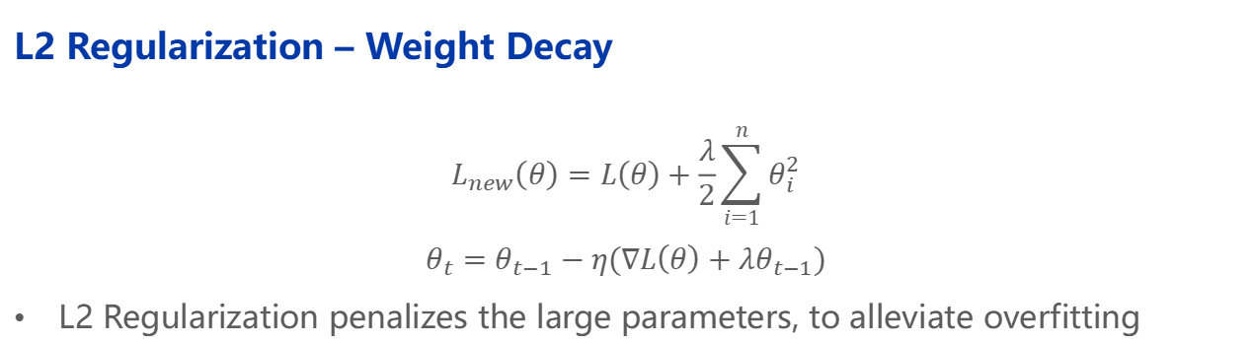
Alleviating Overfitting - Regularization
L2 Regularization – Weight Decay
$$L_{new}\left(θ\right)=L\left(θ\right)+\frac{λ}{2}\sum_{i=1}^{n}{θ_{i}^{2}}$$
$$θ_{t}=θ_{t−1}−η(∇L\left(θ\right)+λθ_{t−1})$$
L2 Regularization penalizes the large parameters, to alleviate overfitting
Data augmentation
Batch normalization
…
What about L1 regularization?-Sparsity
Dropout (Dropblock, Cutout … )
Randomly mask some neurons (Set to 0) in training to boost the robustness of the model, thus alleviate overfitting
Notes:
使用

Slide 25
2 | Convolutional Neural Network and Computer Vision

Slide 26
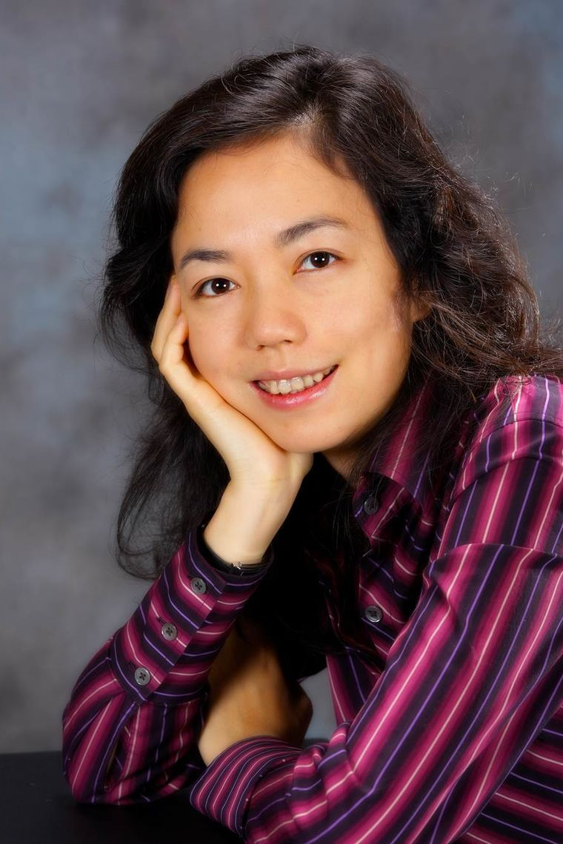

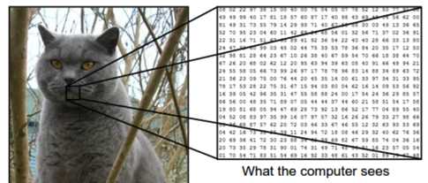

Computer Vision Basic
Goal
Computer vision focuses on how the machines see the human world
The inputs of computer vision are primarily pixel values.
What the human sees
What the computer sees
Dr. Fei-fei Li, Godmother of AI
Stanford CS231n

Slide 27
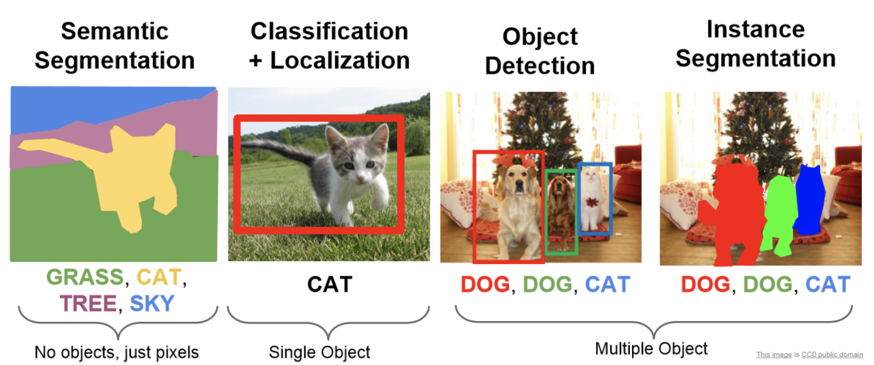
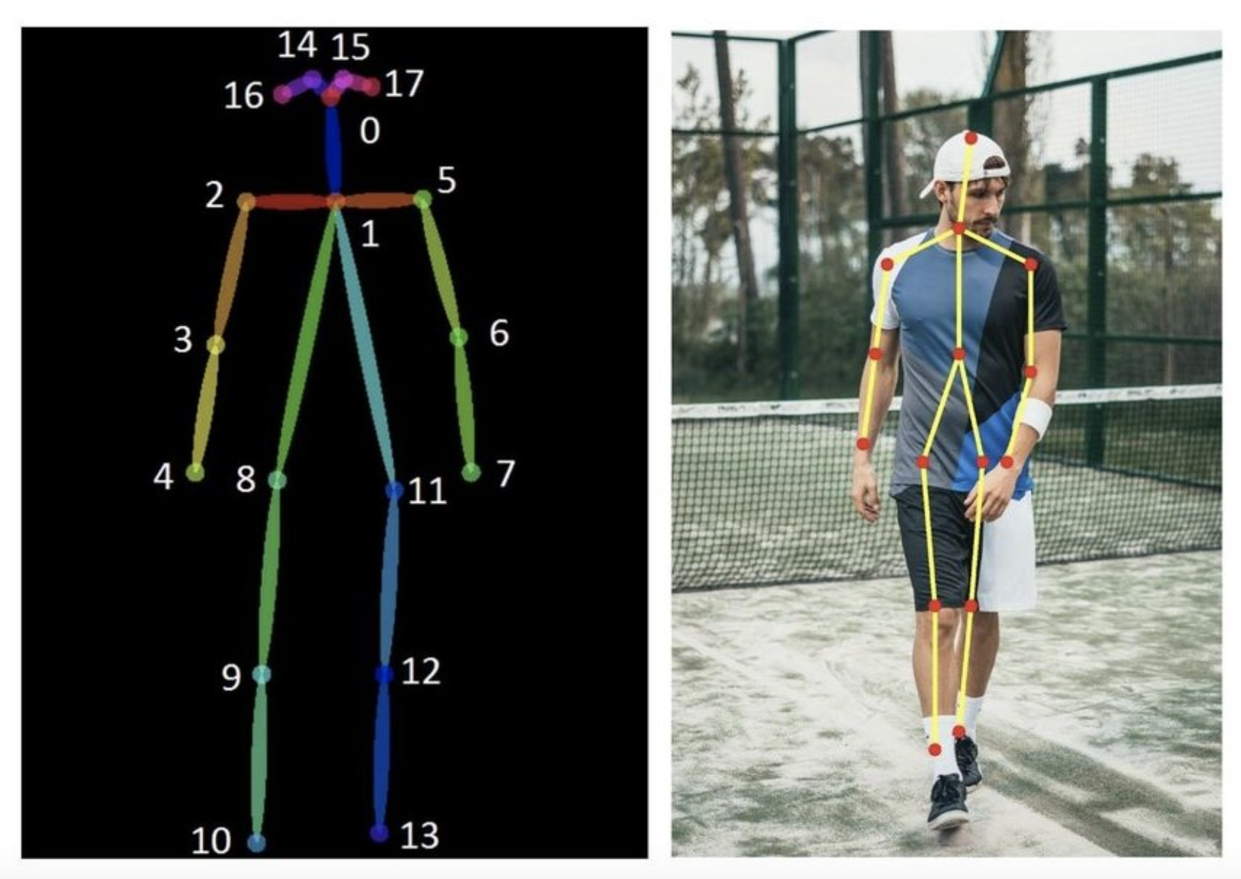
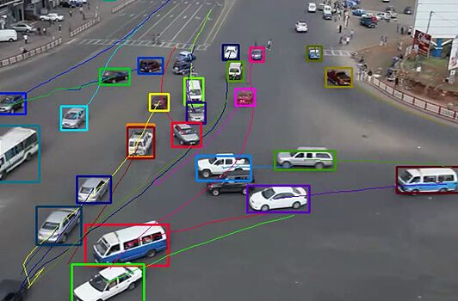
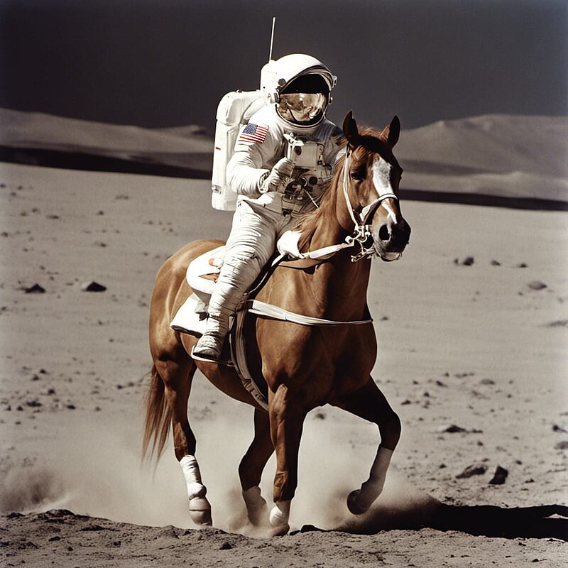
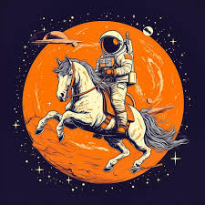
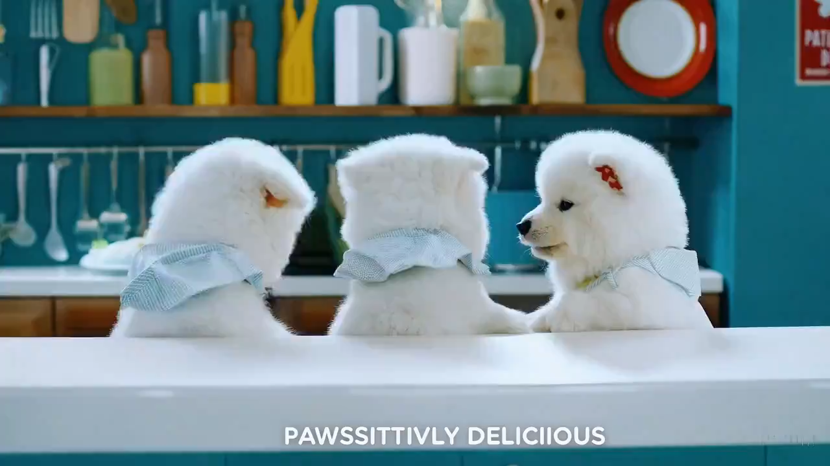
Computer Vision Tasks
The tasks are roughly two types: perception and generation
Pose Estimation
Multiple Object Tracking
prompt
prompt
A horse-riding astronaut on the moon
Cinematic trailer for a group of samoyed puppies learning to become chefs

Slide 28
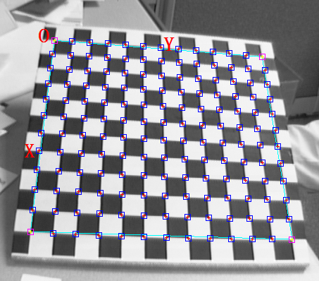
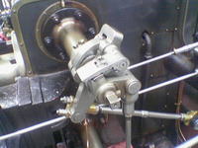
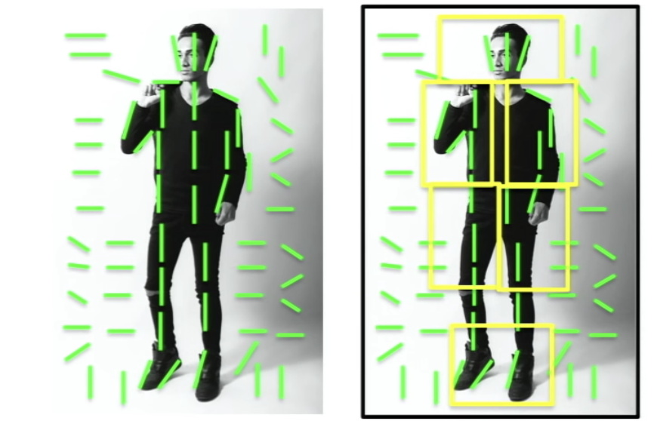
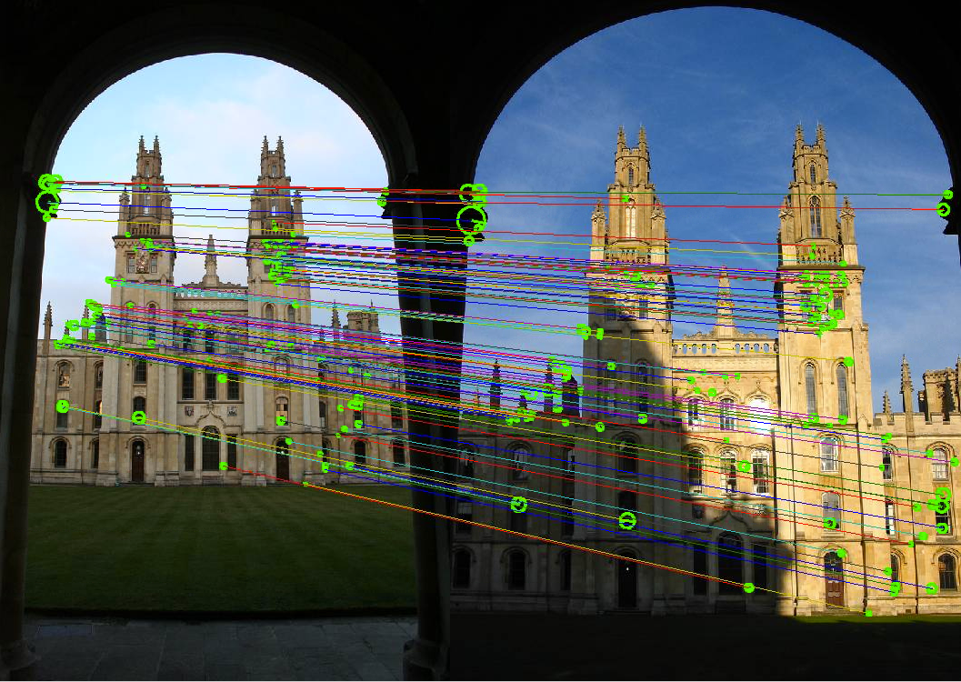
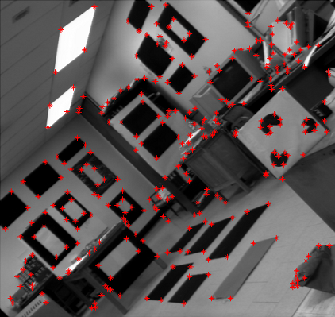
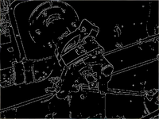
Old Days in Computer Vision
Dominated by hand-crafted features (mimicking how humans see the world)
Feature engineering is very important!
Corner Detection
Edge Detection
HOG Feature
SIFT Feature
Can be easily implemented via the python OpenCV package

Slide 29
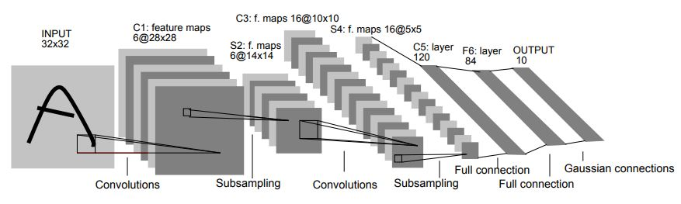

Computer Vision in Deep Learning Era
Transformation from handcrafted features to high-level semantic features
Data-driven research: more data, less human prior
LeNet: one of the earliest CNNs
ImageNet: ~128M images, 1k classes

Slide 30
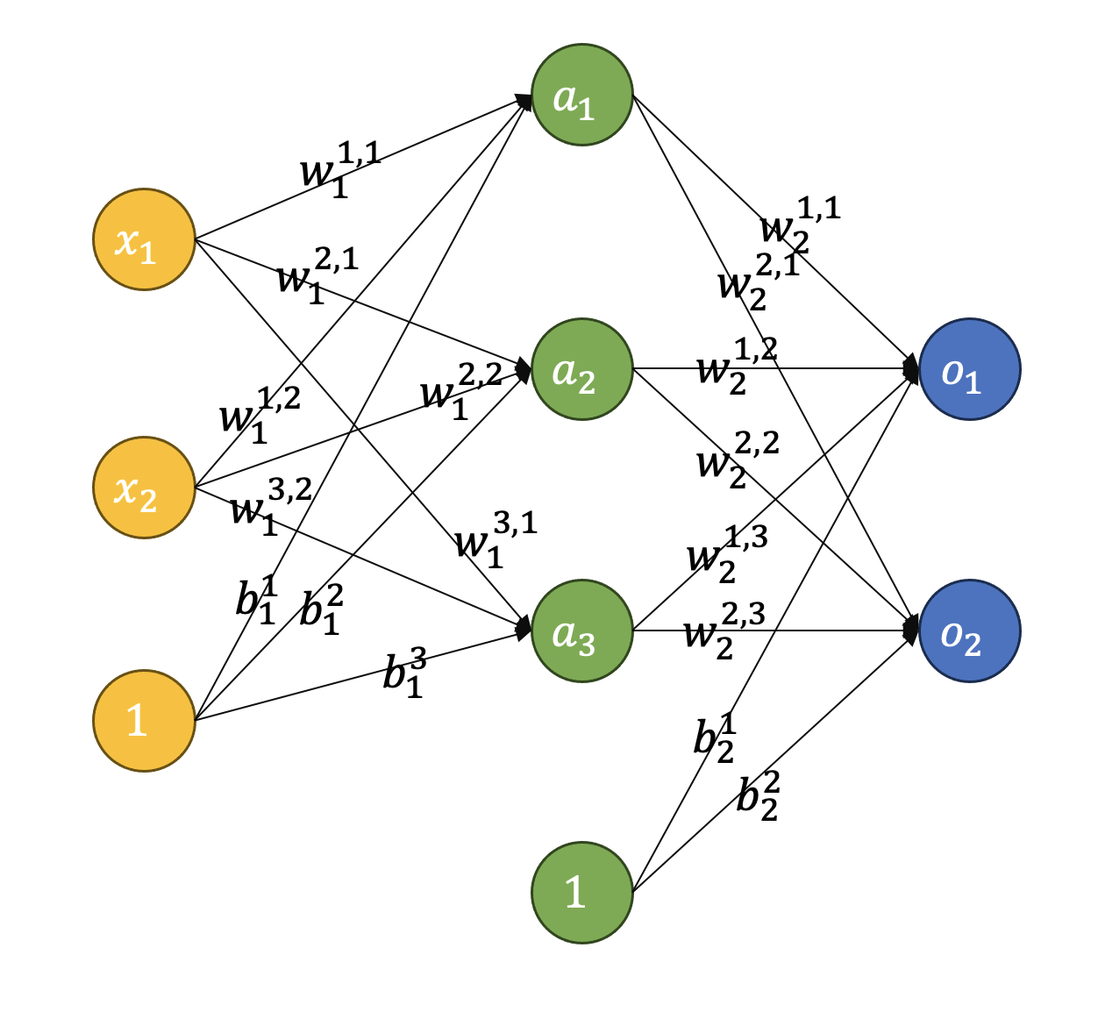
Challenges in Image Processing
Images are high-dimension matrices
Gray-scale images are one-channel and color images are three-channel (RGB)
The pixel values are between 0~255.
Suppose a color image of 224x224, and the hidden dimension is 100
The shape of input is 224x224x3 = 150,528
The shape of weight is 224x224x3x100 = 15,052,800
Very large number of parameters -> high computation & storage cost
And this is just the first layer…
Spatial relationships matter in images
The pixels have a certain spatial relationship, not randomly arranged, like edges, corners, texture, etc.
Flattening the images will destroy the spatial relationships
A fully-connected neural network
Notes:
224x224的图片是非常小的，类比1920x1080

Slide 31
Locally Connected Layers
Sparse connectivity
A hidden unit is only connected to a local patch. The weights connected to the patch are called filter or kernel (滤波器或核).
In biological systems, each cell responds to a specific small region of what it sees, known as a receptive field (感受野). Many cells are tiled to cover the entire visual field.

Slide 32
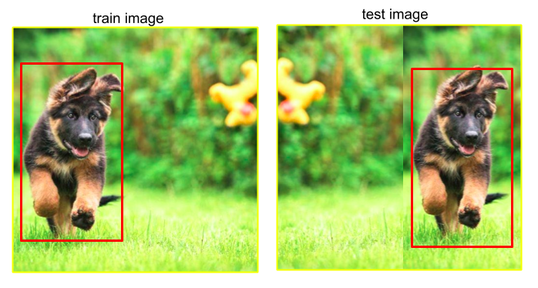
Locally Connected Layers
Translation Invariant
When an object in the image is translated in space (such as moving up and down, left and right), the model can still recognize the object without relearning its new position.
Capture statistics in local patches and they are independent of location. Similar edges may appear at different locations.
Weight Sharing
Hidden nodes at different locations share the same weights -> greatly reduce the number of parameters to learn.
Share weights at the bottom layers to capture the local features. Fully-connect at the top layers to grasp the global features.
Weights with the same color have identical values.

Slide 33

Basic Components of CNNs
Typically, a CNN should contain the following operators, i.e., convolution (卷积), pooling (池化), fully-connected layer (全连接).
From the first layers to the last layers, the features gradually evolve from low-level (edge, texture) to high-level (semantic, category).

Slide 34




Convolution Layer
Convolution is the main building block of CNNs.
Conduct dot product between part of the image (local patch) and the kernel (filter) to model the local patterns.
Share parameters across different locations.
Filter
Input
Input x Filter
Feature Map
For more demos, go to https://poloclub.github.io/cnn-explainer/
Input x Filter
Feature Map

Slide 35



Stride in Convolution Layer
Stride specifies how much we move the filter. Set to 1 by default.
Share parameters across different locations. Suppose stride is s, kernel size is k, the output size is $\left\lfloor \frac{w−k}{s}\right\rfloor +1$

Slide 36



Padding in Convolution Layer
Size of feature map is smaller than the input. How can we maintain the same dimensionality?
Suppose stride is s, kernel size is k, padding is p, the output size is $\left\lfloor \frac{w−k+2p}{s}\right\rfloor +1$

Slide 37




Multiple Kernels
Kernel Size
The channel of images (or features) is not always 1.
For a 2D-convolution, the shape of ONE kernel is $d×k×k$, d is the depth of image (or feature)
Shape of feature
Multiple Kernels
Multiple kernels generate multiple feature maps, which detect the feature distribution of different patterns.
No more feature engineering.
The parameter size of a convolutional layer is $d×k×k×N$ (N is the number of kernels)

Slide 38

Implement Convolution in PyTorch
First, define all the required parameters (input depth, number of kernels, kernel size).
Second, check if the default parameters should be changed (stride=1, padding=0).
Input depth
Number of kernels
Kernel size
By inserting an integral number to stride, padding, kernel_size, the values along height & width are the same.
Or, insert a tuple instead, e.g., kernel_size=(3,5)
https://pytorch.org/docs/stable/generated/torch.nn.Conv2d.html#torch.nn.Conv2d

Slide 39

Pooling
Pooling is used to reduce the dimensionality (down-sampling).
Basically a feature aggregation operation, which selects the most representative values inside a patch (usually works together with convolution).
Why do we need it?
Save computation.
Improve translation invariant. The precise spatial location of the original features is blurred to a certain extent, thereby reducing the model's dependence on the spatial location of the input.
Enlarge receptive field.

Slide 40
Max Pooling & Average Pooling
Max pooling
(down sample size: 2, kernel size: 2)
5
8
-1
3
8
-4
3
3
0
3
8
0
-2
5
6
3
ReLU
0
5
6
3
3
-5
-1
-2
3
0
0
0
2
4.25
1
2
3
1
1
2
3
1
1.5
1
Average pooling
(down sample size: 2, kernel size: 2)

Slide 41

Implement Pooling in PyTorch
Use nn.MaxPool2d for max pooling or AvgPool2d for average pooling.
The required parameters. Include stride and kernel_size.
Check if the default parameters should be changed (e.g., padding).

Slide 42

LeNet
[LeCun et al., 1998]
Architecture is [CONV-POOL-CONV-POOL-FC-FC]
CONV: 5x5 filter, stride=1
POOL: 2x2 filter, stride=2

Slide 43

VGGNet
[Simonyan and Andrew Zisserman, 2014]
VGG is actually the abbreviation of Visual Geometry Group in Oxford University, led by AZ.
Deeper networks
AlexNet: 8 layers
VGGNet: 16 or 19 layers
Small filters
3x3 convolutional layers (stride 1)
2x2 max-pooling, stride 2
VGGNet is the first runner-up of classification and winner of localization of ILSVRC 2014 (imagenet), demonstrating the effectiveness of deeper architecture.

Slide 44
Recall Problems with Deep Architectures
Gradient Vanishing & Gradient Exploding
When the network becomes deeper, the gradient could be very small or very large.
Because of backpropagation, the effects can be accumulated.
Performance Degradation
Deeper networks may exhibit worse performance than the shallower counterparts.
Not caused by over-fitting, but more from but because the optimization problem becomes more difficult (hard to learn effective features).
High Computation Costs
Higher requirements for computation power and memory.
Can be solved by GPU magic!
Performance issues can be alleviated by different activation functions, normalization, and residual operations.
Notes:
比喻：梯度消失和梯度爆炸就像水管，非常长的水管到后面水流会非常小，或者太大的水流造成水管爆裂。

Slide 45

Recall Gradient Vanishment & Explosion
Gradient Vanishing
When the input value of Sigmoid and Tanh functions is very large or small, the derivative is close to zero, e.g.,
$$σ^{′}\left(x\right)=σ\left(x\right)∙\left(1−σ\left(x\right)\right)$$
Deeper networks mean more activation function derivatives are multiplied and gradients decay quickly. Network training becomes very slow, especially parameters close to the input layer are almost impossible to update.
Gradient Exploding
The gradient values ​​of some layers will become excessively large as the number of propagation layers increases, leading to overly drastic parameter updates.
A lack of normalization is one potential cause of this gradient explosion, as extreme values can disproportionately influence the updates.

Slide 46


Batch Normalization
Core idea: if we want Gaussian, we make it Gaussian.
BatchNorm is primarily adopted in computer vision. In NLP, layer normalization is more common. (Will introduce it next week).
Algorithm will converge faster and better.
Steps
Compute mean and variance within a mini-batch.
Conduct normalize operation, where $ε$ is a very small number (${10}^{−8}$) to avoid zero.
$γ$ and $β$ are learnable parameters to restore the expressive power of the network. Without this step, the network will lose its nonlinear transformation capabilities.

Slide 47




Batch Normalization
For a feature of shape $B×C×H×W$, the mean value is computed along the $C$ dimension.
$$μ_{c}=\frac{1}{B×H×W}\sum_{b=1}^{B}{\sum_{h=1}^{H}{\sum_{w=1}^{W}{X_{b,c,h,w}}}}$$
$$σ_{c}=\frac{1}{B×H×W}\sum_{b=1}^{B}{\sum_{h=1}^{H}{\sum_{w=1}^{W}{{{(X}_{b,c,h,w}−μ_{c})}^{2}}}}$$
Training and Inference are Different!
Store mean and variance in training.
Use the stored mean and variance during inference, not the values from current samples.
BatchNorm will not change the output shape.

Slide 48

ResNet
ResNet uses network layers to fit a residual mapping instead of directly trying to fit a desired underlying mapping.
For example, here ResNet try to fit residual F(x) = H(x) – x instead of H(x) directly
Advantages
Mitigates the Vanishing Gradient Problem: Residual networks use skip connections, which allow the information to flow directly through the network, making the training of deep networks more stable.
Easier to Optimize: since the network is only required to learn small adjustments rather than the entire transformation, making the optimization easier.
Better feature representation: Learning residuals allows the network to learn low-level features in the first few layers, and gradually increases the complexity of features in subsequent layers.
Notes:
如果某一层的输入和输出基本相等（即 f(x)≈0），那么网络可以直接跳过这层，依赖前面层的信息。这就是 ResNet 在深层网络中的优势：即使某些层对输出的影响较小，残差连接也能允许这些层“无效”，从而避免了网络不必要的复杂度和过拟合。

Slide 49


Performance Comparison
Training on ImageNet: Plain vs Residual
ResNet152 achieves 4.49% top-5 error and 19.38% top-1 error on ImageNet

Slide 50



Data Augmentation
Images in real world can be noisy.
Implement augmentation operation on the images to learn more robust feature representations.
Rotation, Shifting,
Resizing, Rotate
Cutout
CutMix

Slide 51


Feature Visualization
First few layers: edge & texture detector
Deep layers: more abstract representation, still encode useful features, less visual interpretation

Slide 52

Feature Pyramid
Image contain multiple objects more often than single objects. How to identify objects at different scales?
Features from different layers may contain different information. Exploiting the cross-level features brings richer feature representations.
Image pyramid: can be very slow
Pyramidal feature hierarchy: may have semantic gaps across layers
Feature pyramid network: has rich semantics at all levels and is built quickly from a single input image scale

Slide 53


Practice: Train LeNet on MNIST
Import all necessary packages, torchvision is an amazing package that contains some built-in datasets (e.g., mnist, imagenet), and data transform operation (torchvision.transforms).
list of built-in datasets provided by torchvision

Slide 54

Practice: Train LeNet on MNIST
Define LeNet in PyTorch

Slide 55


Practice: Train LeNet on MNIST
Download or initialize the MNIST dataset.
Define the data transformation operation (could add some augmentations).
User DataLoader to feed mini-batches into the model.
Transform the input to tensor and normalize
Will automatically download the dataset if not exists
Compose the samples into mini-batch for parallel training

Slide 56

Practice: Train LeNet on MNIST
Define some hyper-parameters, like learning rate, total epochs.
Prioritize CUDA use
model.parameters() refers to all learnable parameters, can also set different learning rates for different layers

Slide 57

Practice: Train LeNet on MNIST
Define the training function, including forward and backward
Gradient zeroing to avoid repeated updates
Optimize the parameters

Slide 58

Practice: Train LeNet on MNIST
Define the test function. As the predicted vector is probability, take the one with highest probability as the predicted category.
Take the value with the highest probability as the predicted class

Slide 59

Practice: Train LeNet on MNIST
Train the model and save it after training.
You could also save the one that performs best on the validation set.

Slide 60
3 | NLP and Recurrent Neural Network

Slide 61
NLP – Deal with words
Natural Language Processing
Natural Language Processing (NLP) is a branch of Artificial Intelligence (AI) focused on enabling machines to understand, interpret, and respond to human language.
Key Technologies
Tokenization/Word Embeddings
RNN/LSTM/GRU
Transformer Architectures
Today, in this chapter, we will talk mainly about some fundamental concepts and algorithms of NLP. As for how to train a language model, we will cover that next week.

Slide 62
Model a Sentence – Tokenization（分词器）
Definition
Tokenization is the process of breaking a text into smaller units, called tokens, such as words, phrases, or subwords.
Purpose
Helps in understanding the structure and meaning of the text
Prepare text data ready for deep learning models
Originally, tokenization is a task in NLP, but it has become a data processing tool for LLM now
Types of Tokenization
Word-level tokens (e.g., "natural", "language").
Subword-level tokens (e.g., "nat", "ural").
Character-level tokens (e.g., "n", "a", "t").

Slide 63
Model a Sentence - Tokenization
Comparison (mainly based on English)
Aspect | Word-level | Subword-level | Character-level
Vocabulary Size | Large (hundreds of thousands) | Medium (tens of thousands) | Small (hundreds of characters)
OOV Words | Poor | Good | Excellent
Sequence Length | Short | Medium | Long
Semantic Completeness | Excellent | Moderate | Low
Generalization | Poor | Good | Very Good
Computational Cost | Low | Moderate | High
Language Adaptability | Requires Language-Specific Rules | Highly Flexible | Universal

Slide 64
中文分词
词典分词法
完全切分匹配（查词典，扫描句子，只要组成一个词就切分）
正向最长匹配（正向扫描句子，匹配到词典中最长的词并切分）
逆向最长匹配（反向扫描句子，匹配到词典中最长的词并切分，解决中文词汇信息后置）
双向最长匹配（同时使用正向和逆向最长匹配，基于规则选择分词，规则可以是选择词频最大切分、词数最少切分等）
例句：欢迎新老师生前来就餐
词典：欢迎 新 老 老师 师生 生前 前来 来 就餐
正向：欢迎/新/老师/生前/来/就餐
逆向：欢迎/新/老/师生/前来/就餐

Slide 65



中文分词与浏览器
当你浏览某些中文网站的时候，随机双击文本部分，你会发现浏览器会自动选中中文词汇，这就是最日常的词典分词器，你可以尝试在Chrome中使用javascript代码唤出Chrome自带的中文分词器。

Slide 66


Model a Sentence – Tokenization
Other tokenization – Statistics
BEMS label (Begin, Middle, End, Single)
Hidden Markov Model (HMM, 隐式马尔科夫模型)
Conditional Random Field (CRF, 条件随机场)
我/s 在/s 复/b 旦/m 大/m 学/e 学/b 习/e 生/b 物/e 信/b 息/m 学/e 课/b 程/e

Slide 67



Tokenization for LLMs
BPE （Byte Pairing Encoder）
BPE is a sub-word tokenizer.
BPE is the most popular tokenizer for LLMs now, used by GPT/LLaMa/Qwen …(should be BBPE)
Algorithm
Iteration 1:
Vocabulary
Vocabulary Pairs
Updated Vocabulary

Slide 68



Tokenization for LLMs
Iteration 2:
Vocabulary
Vocabulary Pairs
Updated Vocabulary
BPE Algorithm.
Initialize vocabulary, broken down into characters.
Count pair frequencies.
Merge the most frequent pair.
Update the corpus.
Repeat step 2-4 for a predefined number of merges.

Slide 69



Tokenization for LLMs - BBPE
What is BBPE – Byte-level BPE
BPE operates at the character level (suitable for alphabetic languages)
BBPE operates at the byte level
BBPE uses UTF-8. UTF-8 is a universal character encoding system. It supports English, Chinese, Spanish, Arabic, French, and Russian etc.
Using byte-level encoding instead of character level solves the problem of OOV.

Slide 70

Word Embedding
One-hot encoding
Vocabulary is a set of tokens, e.g. ["I", "love", "pizza", "apple", "banana"], then we have
"I" → index 0
"love" → index 1
"pizza" → index 2
"apple" → index 3
"banana" → index 4
Convert the categories to one-hot vectors
"I" → [1, 0, 0, 0, 0]
"love" → [0, 1, 0, 0, 0]
"pizza" → [0, 0, 1, 0, 0]
"apple" → [0, 0, 0, 1, 0]
"banana" → [0, 0, 0, 0, 1]
What if we have tens of thousands tokens in the vocabulary?

Slide 71

Word Embedding
What if we have tens of thousands tokens in the vocabulary?
E.g., if we have 30,000 tokens, then the one-hot integer vector has 30,000 dimensions, but it is too sparse (1 and 29,999 zeros).
Solution: compress it to a floating-point 256/512/1024… vector! That is word embedding.
Then we need a 30000x512 floating-point matrix to store these embeddings.
The question is: How can we obtain a good embedding?
512

Slide 72

Word Embedding - Intuition
Sofa ~ couch
Men ~ women
King ~ queen
Apple ~ orange
King – queen ~ men - women

Slide 73

Word Embedding
A Good Embedding
Similar words should be closer in the feature space (You can visualize the feature space using t-SNE or other algorithms).
couch
sofa
table
men
women
banana
king
queen
orange
apple
cat
dog
rabbit

Slide 74

Word2Vec
Word2Vec is an outstanding word embedding encoder, achieving test of time award, NerIPS 2023.
Word2Vec uses a shallow neural network to train the word vector weights.
There are two ways to train Word2Vec
CBOW: Given contexts, predict target
SkipGram: Given target word, predict context

Slide 75

Word2Vec Visualization

Slide 76
Are we using Word2Vec now?
The answer is no.
Some LLMs may use Word2Vec to initialize the embedding layer. However, modern LLMs usually train the embedding layer from scratch. (e.g. a 30000x512 matrix).
This does not undermine the fact that Word2Vec is a groundbreaking algorithm.

Slide 77

Recurrent Neural Network
Difference with CNN
The input and output of an RNN are not fixed

Slide 78















Recurrent Neural Network
$$L^{1}$$
$$L^{2}$$
$$L^{T}$$
$$y_{1}=Softmax\left(Vh_{1}+c\right)$$
$$y^{1}$$
$$y^{2}$$
$$y^{T}$$
$$h^{1}$$
$$h^{2}$$
…..
$$h^{T−1}$$
$$h^{0}$$
$$h_{1}=f\left(Ux_{1}+Wh_{0}+b\right)$$
$$h_{2}=f\left(Ux_{2}+Wh_{1}+b\right)$$
$$x^{1}$$
$$x^{2}$$
$$x^{T}$$
Shared Weights

Slide 79

Recurrent Neural Network
N to 1
Suitable for classification
1 to N
Suitable for image caption
$$y^{T}$$
$$y^{1}$$
$$y^{2}$$
$$y^{T}$$
$$h^{1}$$
$$h^{2}$$
…..
$$h^{T−1}$$
$$h^{1}$$
$$h^{2}$$
…..
$$h^{T−1}$$
$$h^{0}$$
$$h^{0}$$
$$x^{1}$$
$$x^{2}$$
$$x^{T}$$
$$x$$
In fact, the N-to-N RNN does not have many specialized applications.

Slide 80
Recurrent Neural Network
For more flexibility, an encoder-decoder structure is suitable for n-to-m tasks.
Encoder
Decoder
y
y
y
x
x
I love banana. (11个字符) 我喜欢香蕉。 (五个汉字)

Slide 81


Long Short-Term Memory

